Slide 1
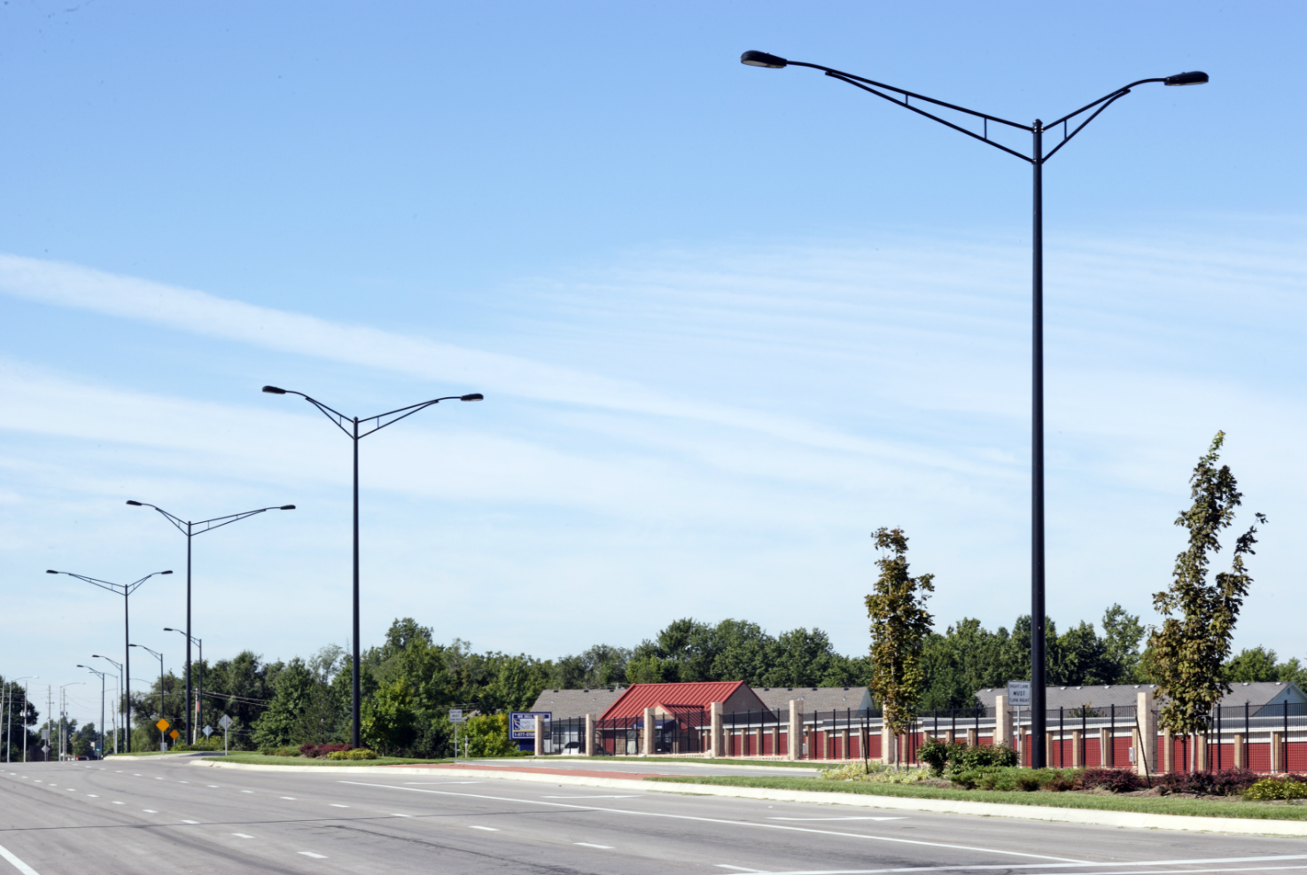
Catalog Logic
Steel and Aluminum
© 2017 Valmont Industries, Inc. All rights reserved.

Slide 2

Catalog Logic & Part Number Construction
DS30-660A300-4S-GV
That’s a galvanized, 6.6 inch diameter, 11 gauge, 30 foot steel round tapered roadway lighting pole with a 4 foot single member pipe arm!

Slide 3

Catalog Logic & Part Number Construction
DS30-660A300-4S-GV

Slide 4
Steel Catalog Logic
DS30-660A300-4S-GV
Design Series
DS30/EM30/DS250 – Round tapered roadway lighting pole with single member pipe arm assembly
DS32 – Round tapered roadway lighting pole with single member tapered arm assembly
DS60/DS70 – Round tapered roadway lighting pole with truss support pipe arm assembly
DS90 – Round tapered roadway lighting pole with davit arm
DS210 – Round tapered area lighting pole
DS220 – Square tapered area lighting pole
DS330 – Square non-tapered area lighting
DSF10/DSF15/DSF20/DSF35 – Square hinged area lighting pole
DS200/DS201/DS202 – Round tapered pedestal pole
DS340 – Round non-tapered area lighting pole

Slide 5
Steel Catalog Logic
DS30-660A300-4S-GV
Nominal Shaft Base Diameter
The description is listed in decimal form with the decimal place always falling between the first two characters (Examples: 660=6.60” and 800=8.00”)
When the base diameter reaches 10.0” or more, the first digit becomes an alpha character (Examples: T=10”, E=11”, W=12”, and H=13”)
Also note T50=10.50”

Slide 6
Steel Catalog Logic
DS30-660A300-4S-GV
Nominal Shaft Wall Thickness, Material Yield, & Cross Section
A=11 Gauge (0.1196”), 55 KSI, Round Tapered
B=10 Gauge (0.1345”), 55 KSI, Round Tapered
4=5 Gauge (0.2092”), 55 KSI, Round Tapered
E=7 Gauge (0.1793”), 55 KSI, Round Tapered
F=0.188” Tubing, 55 KSI, Square Non-Tapered
J=3 Gauge (0.2391”), 55 KSI, Round Tapered
N=7 Gauge (0.1793”), 50 KSI, Square Non-Tapered
Q=11 Gauge (0.1196”), 55 KSI, Square Non-Tapered
V=0.120” Tubing, 42 KSI, Round Non-Tapered
W=7 Gauge (0.1793”), 55 KSI, Square Non-Tapered

Slide 7
Steel Catalog Logic
DS30-660A300-4S-GV
Nominal Shaft Length
The first two digits are measured in feet increments and the last digit is measured in inches (Example: 300=30’-0” and 389=38’-9”)

Slide 8
Steel Catalog Logic
DS30-660A300-4S-GV
Fixture Mounting Method or Luminaire Arm Length
Luminaire Arms – The numeric digits describe the length of the arm and the alpha character describes the number of arms required per pole (Examples: 4S=4’ Single Arm, 8D=8’ Double Arms, and 6F=6’ Quadruple Arms) (S=Single, D=Double, T=Triple, and F=Quadruple)
Tenon Mounting:
P2=2.38” O.D. x 4.0”
P3=3.5” O.D. x 6.0”
P4=4.0” O.D. x 6.0”
P5=2.88” O.D. x 4.0”
PL=2.38” O.D. Plain Top
P9=Special Tenon Size
Drill Mounting:
D1=Drilling for 1 Luminaire
D2=Drilling for 2 @ 180º
D3=Drilling for 3 @ 120º
D4=Drilling for 4 @ 90º
D5=Drilling for 2 @ 90º
D6=Drilling for 3 @ 90º

Slide 9
Steel Catalog Logic
DS30-660A300-4S-GV
Finish Coatings
BK=Black
DB=Dark Bronze
DG=Dark Green
HG=Hunter Green
LG=Light Green
MB=Medium Bronze
RD=Red
WH=White
SL=Silver
SG=Slate Gray
ST=Sandstone
CB=Bronze
SM=Silver Metallic
DT=Dark Tan
BN=Brown
GV=Galvanized
FPGV= Finished paint over galvanized + color

Slide 10
Aluminum Catalog Logic
2908-40705T4P2DDB
Nominal Shaft Length
The first two digits are measured in feet increments and the last two digits are measured in inches (Example: 2908=29’-8” and 3808=38’-8”)

Slide 11
Aluminum Catalog Logic
2908-40705T4P2DDB
Nominal Shaft Top Diameter
The description is listed in inches (Examples: 29=2-7/8”, 30=3”, 40=4”, 45=4-1/2”, 50=5”, and 60=6”)

Slide 12
Aluminum Catalog Logic
2908-40705T4P2DDB
Nominal Shaft Base Diameter
The description is listed in inches (Examples: 30=3”, 40=4”, 45=4-1/2”, 50=5”, 60=6”, 70=7”, 80=8”, and 10=10”)

Slide 13
Aluminum Catalog Logic
2908-40705T4P2DDB
Nominal Shaft Wall Thickness
The description is listed in 32nds of an inch (Examples: 4=4/32” or 0.125”, 5=5/32” or 0.156”, 6=6/32” or 0.1888”, and 8=8/32” or 0.250”)

Slide 14
Aluminum Catalog Logic
2908-40705T4P2DDB
Shape of Shaft
T=Tapered Round
S=Straight Round
Y=Square Straight
D=Davit
X=Cruciform Straight

Slide 15
Aluminum Catalog Logic
2908-40705T4P2DDB
Base or Mounting
4=4 Bolt anchor base
3=3 Bolt anchor base
P=Pedestal base (3 bolt)
E=Embedded
H=Hinged base

Slide 16
Aluminum Catalog Logic
2908-40705T4P2DDB
Fixture Mounting Method
Tenon Mounting:
P2=2.38” O.D. x 4.0”
P3=3.5” O.D. x 6.0”
P4=4.0” O.D. x 6.0”
P5=2.88” O.D. x 4.0”
PL=2.38” O.D. Plain Top
P9=Special Tenon Size
Drill Mounting:
D1=Drilling for 1 Luminaire
D2=Drilling for 2 @ 180º
D3=Drilling for 3 @ 120º
D4=Drilling for 4 @ 90º
D5=Drilling for 2 @ 90º
D6=Drilling for 3 @ 90º

Slide 17
Aluminum Catalog Logic
2908-40705T4P2DDB
Finish Coatings
Polyester Powder:
DBL=Black
DBR=Bright Red
DCG=Charcoal Gray
DDB=Dark Bronze
DMB=Medium Bronze
DNA=Natural Aluminum
DSB=Steel Blue
DSS=Sandstone
DTG=Dark Green
DWH=White
Anodized:
204=Clear Natural
311=Light Bronze*
312=Medium Bronze*
313=Dark Bronze*
335=Black*
* Duranodic Anodized
Brushed:
SBF=Satin Brushed Finish

Slide 18
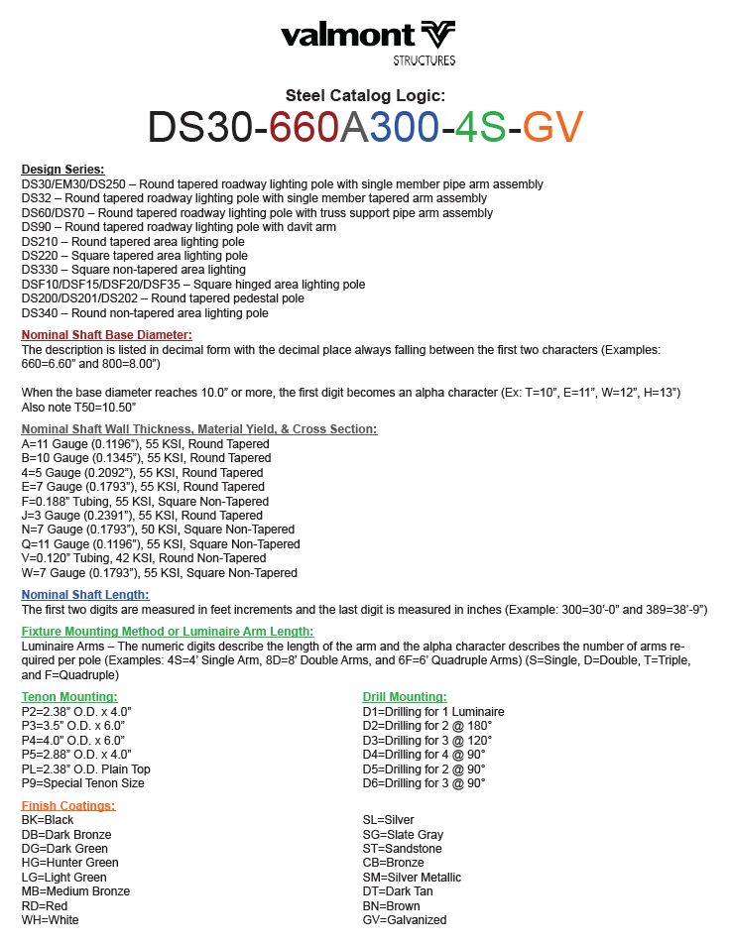
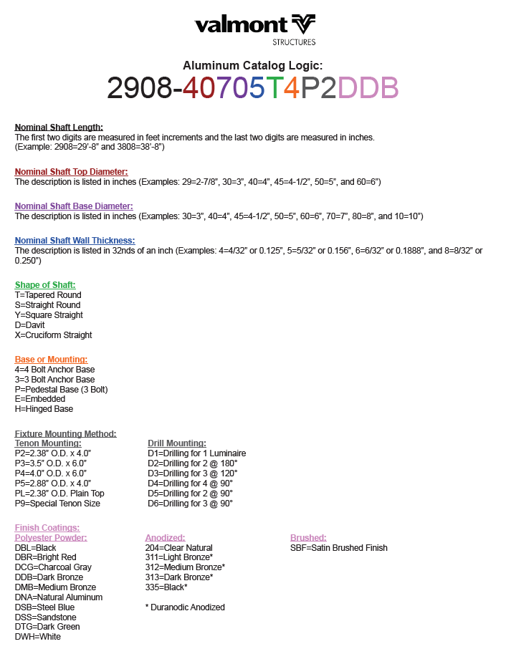
Resources

Slide 19
THANK YOU!
valmontstructures.com

